Slide 1
Did you guys have your Java today?

Slide 2
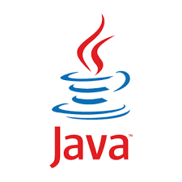

JAVA = Coffee =Programming Language
=

Slide 3
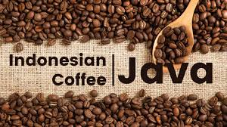
How JAVA got its name?
The language was initially called Oak after an oak tree that stood outside Gosling's office. Later the project went by the name Green and was finally renamed Java, from Java coffee, the coffee from Indonesia.

Slide 4
What is JAVA?
A programming language.
As defined by Gosling, Joy, and Steele in the Java Language Specification
A platform
A virtual machine (JVM).
Runtime environments in diverse hardware.
A class library
Standard APIs for GUI, data storage, processing, I/O, and networking.

Slide 5
Origin of JAVA
Java, was developed as a part of the Green project at Sun. It was started in December '90 by Patrick Naughton, Mike Sheridan and James Gosling and was chartered to spend time trying to figure out what would be the "next wave" of computing and how we might catch it. They came to the conclusion that at least one of the waves was going to be the convergence of digitally controlled consumer devices and computers.

Slide 6
Why JAVA?
Programming in Java is very different than in C/C++
much more language support
error handling
no pointers! (garbage collection)
threads are part of the language.
some support for common application level protocols (HTTP).
dynamic class loading and secure sandbox execution for remote code.
source code and byte code-level portability.

Slide 7
How JAVA works?
Java's platform independence is achieved by the use of the Java Virtual Machine.
A Java program consists of one or more files with a .java extension.
These are plain old text files.
When a Java program is compiled the .java files are fed to a compiler which produces a .class file for each .java file.
The .class file contains Java byte code.
Byte code is like machine language, but it is intended for the Java Virtual Machine .

Slide 8
HelloWorld.java
/**
* A simple program
*/
public class HelloWorld
{
public static void main(String[] args)
{
System.out.println("HELLO GLC-103!");
}
}

Slide 9
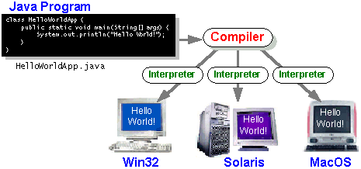

Slide 10
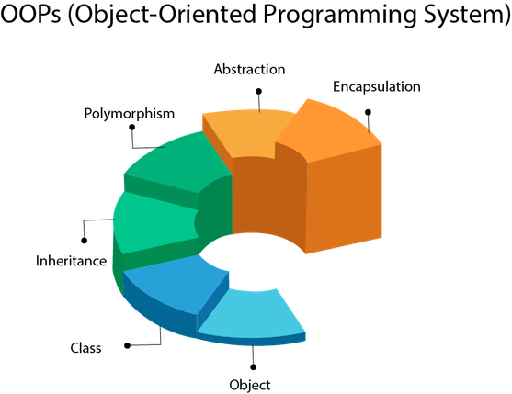
Pillars of Java

Slide 11
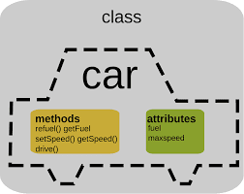
Class & Object

Slide 12
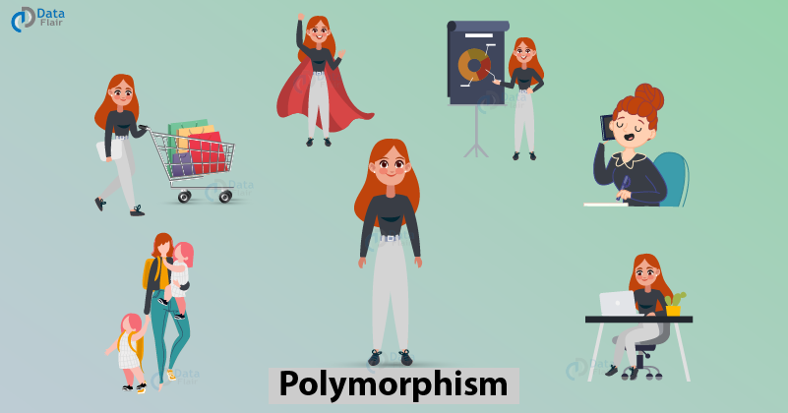
Polymorphism
Polymorphism means to have many forms.

Slide 13
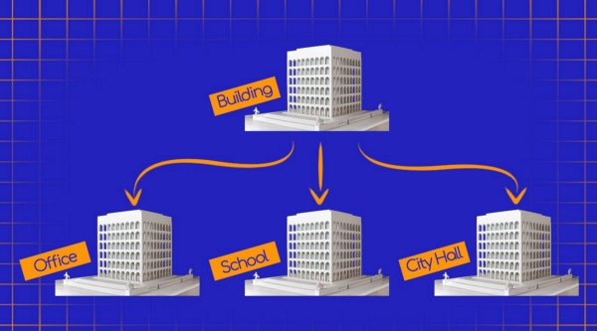
Inheritance
The process by which one class acquires the properties(data members) and functionalities(methods) of another class is called inheritance.

Slide 14
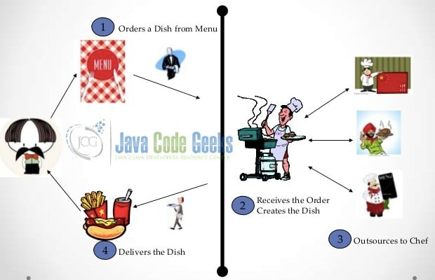
Abstraction
Hiding of unnecessary details from the User.

Slide 15
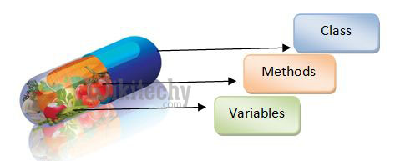
Encapsulation
Encapsulation is defined as the wrapping up of data under a single unit.

